Slide 1
Perpendicular bisector of a line segment
Constructions

Slide 2
how to use Oak lessons

Slide 3
I can use the properties of a rhombus to construct a perpendicular bisector of a line segment.

Slide 4
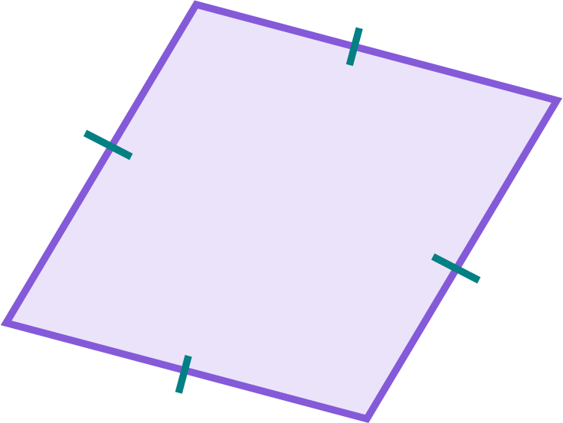
To bisect means to cut or divide an object into two equal parts.
A rhombus is a parallelogram where all sides are the same length.

Slide 5

Perpendicular bisector of a line segment
Constructing rhombi to bisect a line segment
Efficient construction of a perpendicular bisector

Slide 6
Constructing rhombi to bisect a line segment
In a rhombus, one diagonal is the perpendicular bisector of the other.
meets at right angles
bisector - divide into two equal parts
4 cm
4 cm
A perpendicular bisector divides a line segment into two equal parts at a right angle.

Slide 7


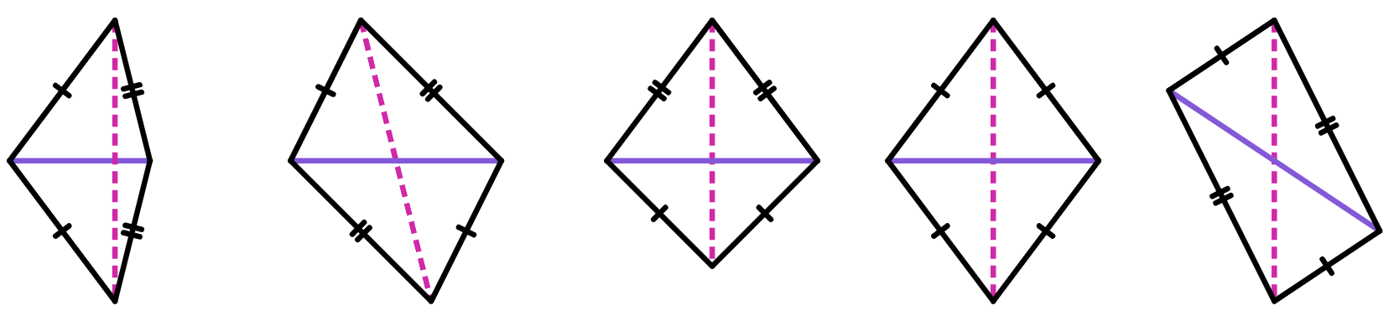
Constructing rhombi to bisect a line segment
Which of these shows a perpendicular bisector on a rhombus?
a
b
c
d
e
All the other quadrilaterals are not rhombi, because they do not have four equal sides.
Many of the incorrect answers also do not look like the diagonals meet at right angles.

Slide 8
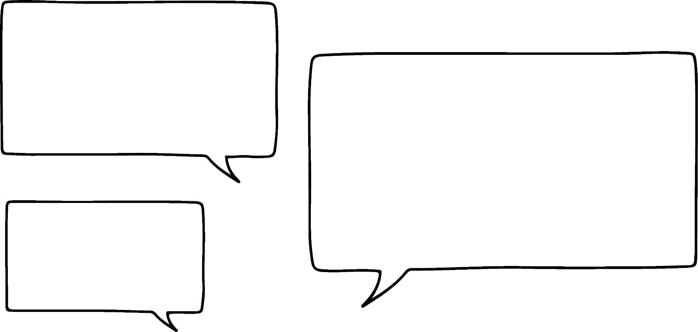

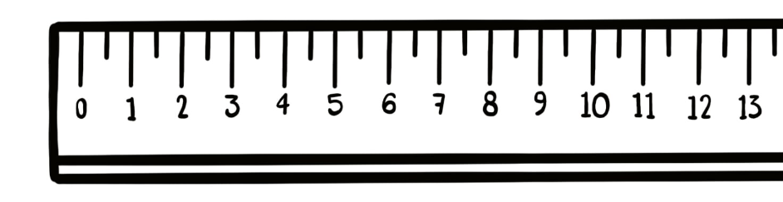
Constructing rhombi to bisect a line segment
Drawing a perpendicular bisector of a line segment is easy!
Construct the perpendicular bisector of line segment AB.
Jacob
Just measure it using a ruler and find its midpoint.
A
B

Slide 9
Constructing rhombi to bisect a line segment
Ah, bisecting might be easy, but how can I make sure it’s a right angle?
Construct the perpendicular bisector of line segment AB.
Jacob
A
B

Slide 10
Constructing rhombi to bisect a line segment
You can construct a rhombus with a line segment as its diagonal in order to find the line segment’s perpendicular bisector.
It can be any rhombus, as long as AB is its diagonal.
One vertex of the rhombus will be above the diagonal, and the other below it.
A
B
4 cm
4 cm
Each vertex must be an equal distance away from the two endpoints of the diagonal line segment.

Slide 11
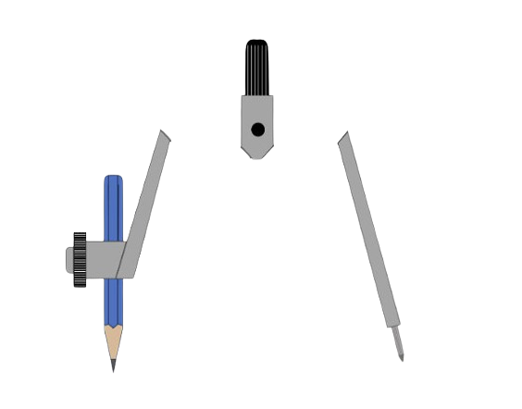
Constructing rhombi to bisect a line segment
By constructing a circle with the compass needle at the endpoint B, I can find all points a certain distance away from B.
4 cm
A
B
4 cm

Slide 12
Constructing rhombi to bisect a line segment
I can repeat this step at the endpoint A.
Because all sides of a rhombus are equal length, I need to make sure both of my circles are exactly the same size.
4 cm
A
B
4 cm

Slide 13
Constructing rhombi to bisect a line segment
The two intersections of the circles are both 4 cm away from A and B.
And so can be used as the two final vertices of the rhombus.
4 cm
4 cm
A
B
Drawing a straight line between these two vertices will give you the second diagonal of the rhombus: the perpendicular bisector.
4 cm
4 cm

Slide 14

Constructing rhombi to bisect a line segment
Alex has started the construction of a rhombus to find the perpendicular bisector of line PQ.
What has Alex done wrong in the construction?
Alex
a
Hasn’t used both intersections of the circles.
b
Both circles are definitely not the same size.
P
Q
c
Hasn’t drawn a perpendicular line.
d
Hasn’t constructed a rhombus.

Slide 15
Constructing rhombi to bisect a line segment
Alex has started the construction of a rhombus to find the perpendicular bisector of line PQ.
What has Alex done wrong in the construction?
Alex
If you only use one of the two intersections of the circles, there’s no guarantee that you’ll draw a line perpendicular to PQ.
Both intersections have to be used to construct a rhombus.
P
Q

Slide 16
Constructing rhombi to bisect a line segment
Both circles have to be the same size, but they can be any size, as long as they intersect.
The radius of each circle has to be greater than half the length of the line segment to ensure they do intersect.
over 5 cm
A
B
10 cm

Slide 17
Constructing rhombi to bisect a line segment
Line segment AB is 5 cm long.
Construct a rhombus to find the perpendicular bisector of AB.
Line segment AB is 4 cm long.
Construct a rhombus to find the perpendicular bisector of AB.
I will construct the rhombus on the left.
After each set of steps, perform the same steps for the rhombus on the right.

Slide 18
Constructing rhombi to bisect a line segment
Use a ruler to draw a line segment of 5 cm.
Line segment AB is 4 cm long.
Construct a rhombus to find the perpendicular bisector of AB.
A
B
A
B
Try it yourself.

Slide 19
Constructing rhombi to bisect a line segment
Place the compass needle at point A.
Set the pencil to be closer to B than A.
Draw a circle.
Line segment AB is 4 cm long.
Construct a rhombus to find the perpendicular bisector of AB.
A
B
A
B
Try it yourself.

Slide 20
Constructing rhombi to bisect a line segment
Repeat the previous step for point B.
Line segment AB is 4 cm long.
Construct a rhombus to find the perpendicular bisector of AB.
A
B
A
B
Try it yourself.

Slide 21
Constructing rhombi to bisect a line segment
Mark the two locations that the two circles intersect.
Join these two intersections to points A and B.
Line segment AB is 4 cm long.
Construct a rhombus to find the perpendicular bisector of AB.
A
B
A
B
Try it yourself.

Slide 22
Constructing rhombi to bisect a line segment
Draw on the other diagonal of the rhombus to find the perpendicular bisector of AB.
Line segment AB is 4 cm long.
Construct a rhombus to find the perpendicular bisector of AB.
A
B
A
B
Try it yourself.

Slide 23
Constructing rhombi to bisect a line segment
1) Give an explanation for why each construction doesn’t result in a perpendicular bisector of the line segment XY, and what can be done to make their construction better.
a)
b)
c)
X
Y
X
Y
X
Y

Slide 24
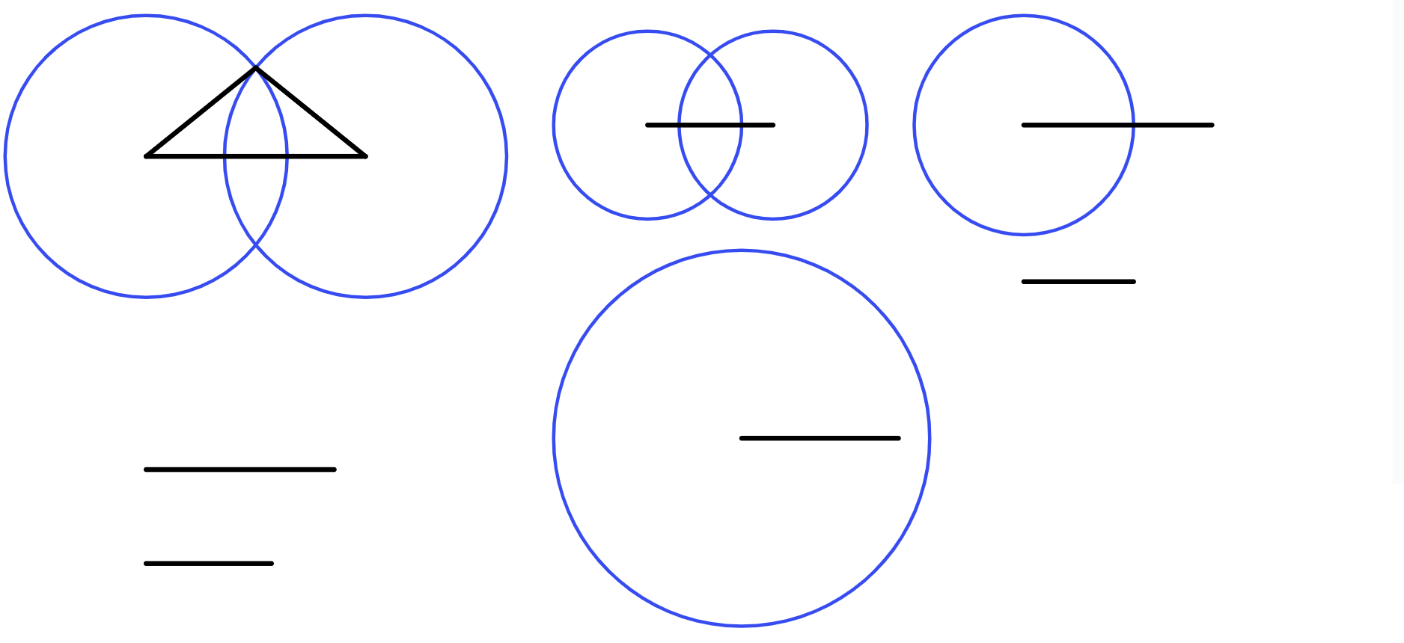
Constructing rhombi to bisect a line segment
2) Find the perpendicular bisector for each line segment by constructing a rhombus.
C
D
A
B
E
F
G
H

Slide 25
Constructing rhombi to bisect a line segment
1) Give an explanation for why each construction doesn’t result in a perpendicular bisector of the line segment XY.
a)
Both circles are too small; they do not intersect.
Make each circle bigger so they can intersect with each other, but check that both circles are still the same size.
X
Y

Slide 26
Constructing rhombi to bisect a line segment
1) Give an explanation for why each construction doesn’t result in a perpendicular bisector of the line segment XY.
b)
Both circles are different sizes.
After constructing the first circle, check that your pair of compasses are still the same width apart so the second circle is the same size as the first.
You can even draw a reference line to use before you draw any circles.
X
Y

Slide 27
Constructing rhombi to bisect a line segment
1) Give an explanation for why each construction doesn’t result in a perpendicular bisector of the line segment XY.
c)
The compass needle wasn’t placed at the endpoints X and Y. The circles are in the wrong place for the perpendicular line to be a bisector.
Make sure that you start each circle with the compass needle at one endpoint of the line segment you want to bisect.
X
Y

Slide 28
Constructing rhombi to bisect a line segment
2) Find the perpendicular bisector for each line segment by constructing a rhombus.
C
C
D
D
A
A
B
B
E
F
G
H

Slide 29
Perpendicular bisector of a line segment
Constructing rhombi to bisect a line segment
Efficient construction of a perpendicular bisector

Slide 30
Efficient construction of a perpendicular bisector
You can accurately construct a rhombus by drawing the arcs of a circle.
The four arcs will create two intersections, one on each side of the line segment.
P
Q
This is a more efficient way to construct a perpendicular bisector.

Slide 31
Efficient construction of a perpendicular bisector
It is still possible to construct full rhombi using just these arcs.
However, you can construct the perpendicular bisector by directly drawing a line that passes through both intersections.
There is no need to draw the sides of the rhombus.
P
Q

Slide 32
Efficient construction of a perpendicular bisector
Which of these diagrams show an accurate construction of a perpendicular bisector of the line segment KL?
a
b
c
d
K
L
K
L
K
L
K
L
b doesn’t look like it’s a bisector - as the vertical line doesn’t intersect KL at its midpoint. d doesn’t have construction lines - so we cannot assume the vertical line has been drawn in the correct place.

Slide 33
Efficient construction of a perpendicular bisector
Construct a perpendicular bisector to a 5.5 cm line segment AB using only circular arcs.
Construct a perpendicular bisector to a 4.2 cm line segment AB using only circular arcs.
A
A
5.5 cm
4.2 cm
B
B
Try it yourself.

Slide 34
Efficient construction of a perpendicular bisector
Set your pair of compasses to a width over half the length of AB.
Construct a perpendicular bisector to a 4.2 cm line segment AB using only circular arcs.
A
A
B
B

Slide 35
Efficient construction of a perpendicular bisector
Place the compass needle onto point B and draw two arcs, one on each side of AB.
Construct a perpendicular bisector to a 4.2 cm line segment AB using only circular arcs.
A
A
B
B
Try it yourself.

Slide 36
Efficient construction of a perpendicular bisector
You can reset the width of the pair of compasses by placing the compass needle on B,
Construct a perpendicular bisector to a 4.2 cm line segment AB using only circular arcs.
and setting the pencil to touch one of the arcs you have already drawn.
A
A
B
B

Slide 37
Efficient construction of a perpendicular bisector
Construct two more arcs, now with the compass needle on point A.
Construct a perpendicular bisector to a 4.2 cm line segment AB using only circular arcs.
A
A
B
B
Try it yourself.

Slide 38
Efficient construction of a perpendicular bisector
Drawing a line segment between the two intersections creates a perpendicular bisector for AB.
Construct a perpendicular bisector to a 4.2 cm line segment AB using only circular arcs.
A
A
B
B
Try it yourself.

Slide 39
Efficient construction of a perpendicular bisector
The perpendicular bisector should have divided AB into two equal halves.
Construct a perpendicular bisector to a 4.2 cm line segment AB using only circular arcs.
A
2.75 cm
2.1 cm
A
5.5 cm
4.2 cm
B
B
Try it yourself.

Slide 40
Efficient construction of a perpendicular bisector
Efficient construction of a perpendicular bisector
1) Complete the construction of each perpendicular bisector.
a)
b)
c)
d)
e)

Slide 41
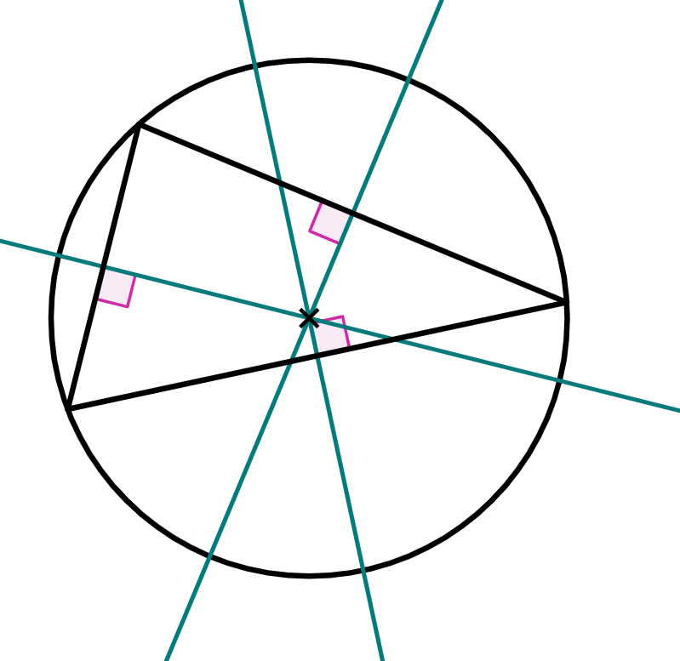
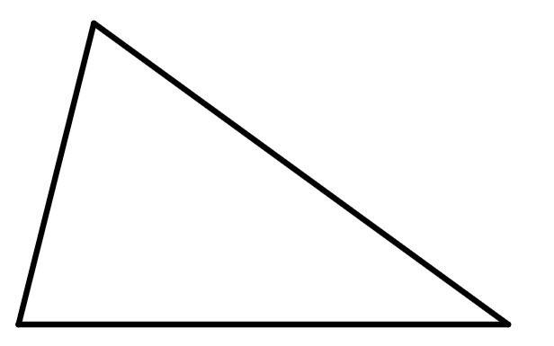
Efficient construction of a perpendicular bisector
Efficient construction of a perpendicular bisector
2) The circumcentre of a triangle is a point that is the centre of a circle whose circumference intersects all three vertices of the triangle. The circumcentre can be found by finding the point where the perpendicular bisectors of each side of the triangle intersect.
Find the circumcentre of this triangle.

Slide 42
Efficient construction of a perpendicular bisector
Efficient construction of a perpendicular bisector
1) Complete the construction of each perpendicular bisector.
a)
b)
c)
d)
e)

Slide 43
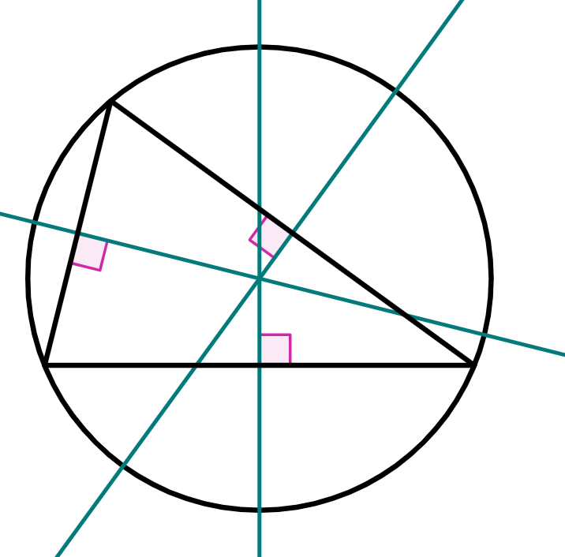
Efficient construction of a perpendicular bisector
Efficient construction of a perpendicular bisector
2) The circumcentre of a triangle is a point that is the centre of a circle whose circumference intersects all three vertices of the triangle. The circumcentre can be found by finding the point where the perpendicular bisectors of each side of the triangle intersect.
Find the circumcentre of this triangle.

Slide 44
Perpendicular bisector of a line segment
A perpendicular bisector is a line that intersects a line segment at right-angles and divides the line segment into two equal parts.
A rhombus can be constructed by drawing two equal-sized circles at the endpoints of a line segment. The line segment becomes a diagonal of this rhombus, with the other diagonal the perpendicular bisector of the original line segment.
The construction of a perpendicular bisector can be made more efficient by drawing only four arcs that create two intersections.

Slide 45

© Oak National Academy 2023.
Produced in partnership with Mathematics in Education and Industry.
Licensed on the Open Government Licence v3.0, except where otherwise stated. See Oak terms and conditions.

